Slide 1
Presentation to Queen's Global Energy Conference
JoAnne Butler, Vice President, Market & Resource Development, IESO
February 10, 2017

Slide 2
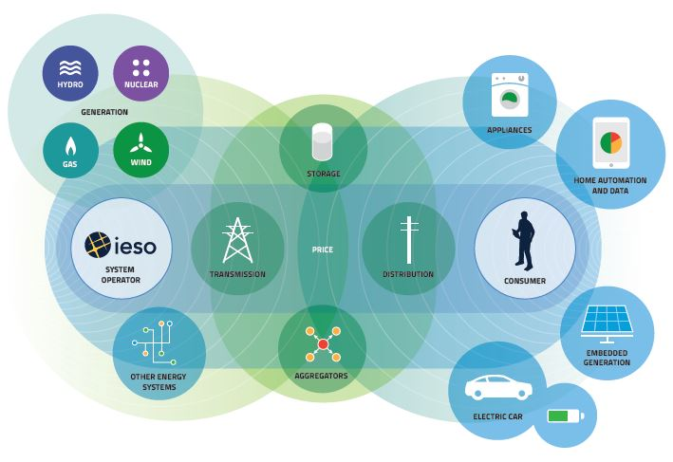
A Changing Electricity System

Slide 3

Ontario’s IESO: Not Your Average ISO
The Independent Electricity System Operator (IESO) works at the heart of Ontario's power system – ensuring there is enough power to meet the province's energy needs in real time while also planning and securing energy for the future
We do this by:
Planning
Enabling Conservation
Operating the Grid and Wholesale Market
Ensuring Supply
Engaging Stakeholders and Communities

Slide 4
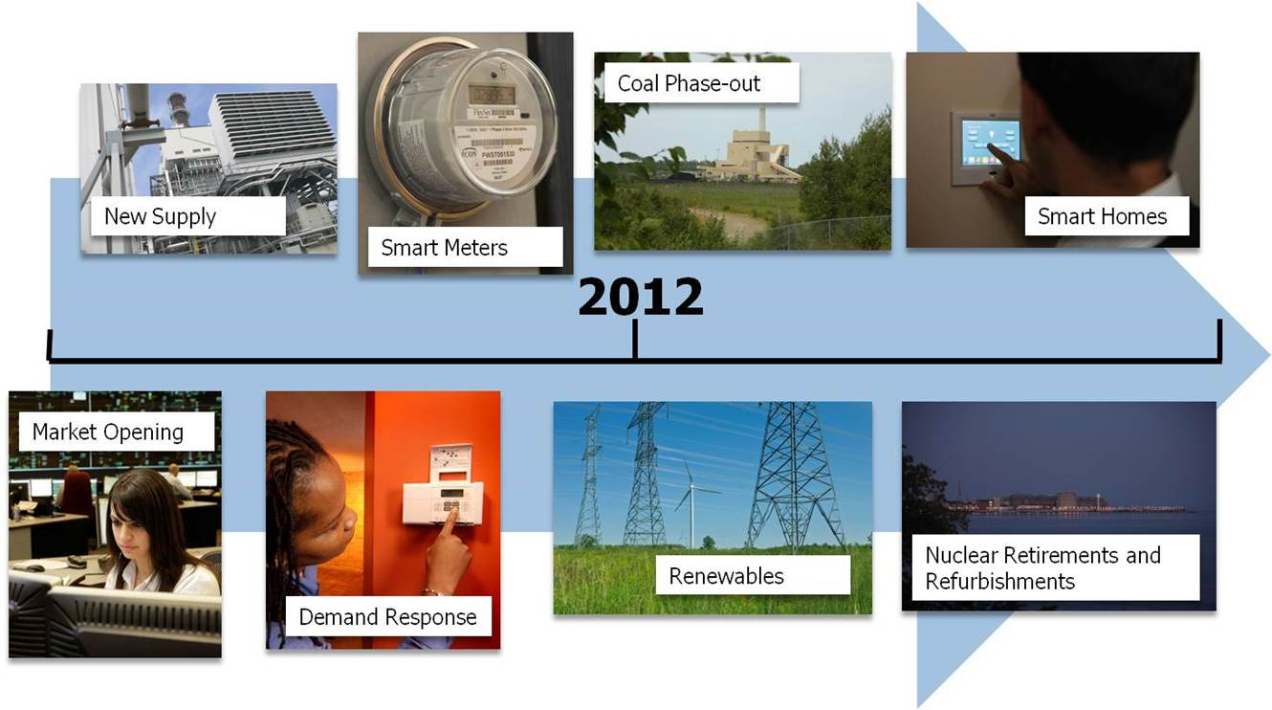
An Evolving Supply Mix
2003 Ontario government commits to coal plant closures
First wind farms commissioned
Lakeview Coal Generating Station closes
Ontario announces Feed-In- Tariff program
2009 Demand decreases 6.1% compared to the previous year
2010 Ontario Long Term Energy Plan target– 10,700 MW of renewable energy
3.6 million Ontarians on Time- Of-Use rates
2014 Remaining coal facilities close

Slide 5
Ontario’s Electricity Supply - Capacity
2005
2015
2025
Demand Response
Demand Response
Coal
Solar/Wind/Bioenergy
Solar/Wind/Bioenergy
Solar/Wind/Bioenergy
Nuclear
Nuclear
Nuclear
Water
Water
Natural Gas
Water
Natural Gas
Natural Gas
Reflects transmission grid connected and embedded generation, at year end.

Slide 6
Ontario’s Electricity Supply - Energy
2005
2015
2025
Coal
Solar/Wind/Bioenergy
Solar/Wind/Bioenergy
Solar/Wind/Bioenergy
Nuclear
Water
Nuclear
Nuclear
Water
Natural Gas
Natural Gas
Water
Natural Gas
Reflects transmission grid connected and embedded generation, at year end.

Slide 7

Renewable Resources and Operability
What are we seeing?
Growth in grid-connected renewable generation
Increased penetration of distributed energy resources (DERs)
Impacts on frequency, voltage and power flows
Emerging technologies, inc. storage, smart grid applications, grid intelligence and analytics
Reduced flexibility of the resource fleet
Challenges associated with forecasting generation output (Tx- and Dx-connected), demand for electricity, consumer behaviour, conservation effects
Need for improved situational awareness
What have we done?
Improved forecasting capabilities – not just of Tx-connected wind farms but also Dx-connected facilities with installed capacity greater than or equal to 5 MW
Transitioned contract-based demand response to a competitive auction
Approved demand response pilot projects to test new technologies
Examined ways to get additional flexibility from existing and new resources
Launched a pilot project with PowerStream as a first step towards enhancing IESO/LDC coordination
Improved tools, processes, modelling and training
Issued an RFI and an RFP for additional regulation service
Integrated energy storage (Alternative Technologies for Regulation, 2012; Storage Phase 1, 2014; Storage Phase 2, 2015)

Slide 8

Leading a Culture of Conservation
Energy conservation is a key resource in helping customers save energy and helping the province reduce its demand for electricity.
Since 2006, Ontario has saved 9.9 billion kilowatt-hours of electricity through programs and changes to codes and standards
2011-2014 saveONenergy programs exceeded the provincial energy-saving target
In 2015, the IESO launched the six-year Conservation First Framework
7 terawatt-hours (TWh) of energy savings from conservation programs delivered by LDCs and
1.7 TWh through conservation projects with transmission-connected customers

Slide 9

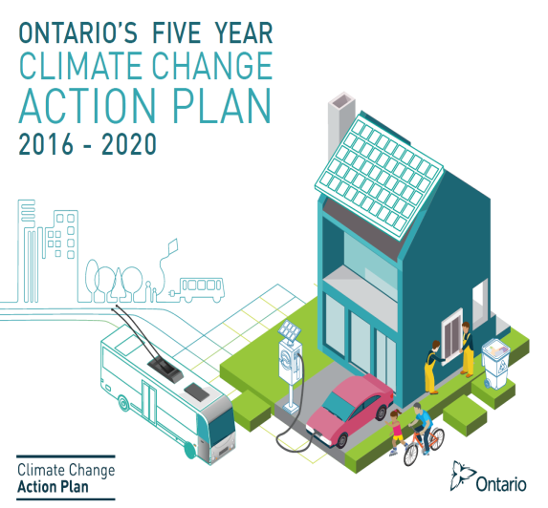
Other Drivers of Change
The IESO’s Ontario Planning Outlook:
Provides a 10-year review (2005-2015) and a 20-year outlook (2016-2035) for Ontario’s electricity system
Responds to a June 10, 2016 request from the Minister of Energy for a technical report on the adequacy and reliability of Ontario’s electricity resources
Provides insights and considerations for the operational needs associated with implementing low-carbon resources, electrification and the growth of distributed energy resources
Serves as a key input to the government’s Long-Term Energy Plan (industry and public consultations are underway)
The Government of Ontario’s Climate Change Action Plan
Was released on June 8, 2016
Describes the actions the province will take over the next five years to fight climate change, reduce greenhouse gas pollution and help move Ontario to a prosperous low-carbon economy
Includes a detailed list of action items, intended funding, and timetables to help the province achieve its greenhouse gas reduction targets through the cap and trade program
Notes:
On September 1, 2016, the IESO provided the Minister of Energy with the Ontario Planning Outlook, an independent report analyzing a variety of planning scenarios for the future of Ontario’s energy system.
This report is expected to serve as the foundation for the government’s next Long-Term Energy Plan, which is scheduled to be released in 2017.
As part of this process, consultations with consumers, businesses, stakeholders and Indigenous communities began in late October.
Here are a few high-level findings of the OPO:
Because of current and past investments, Ontario is well-positioned to meet provincial needs until the mid-2020s, while continuing to adapt to significant change across the sector.
Implementation of the province’s climate change policies will have an impact on the demand for electricity, including through greater electrification of the economy.
There are a lot of variables, but our models suggest that electrification could result in long-term provincial electricity demands that are up to 40% higher than today.
In higher demand outlooks, additional investments in new resources (conservation, generation and transmission) would be required to meet the increase in demand. However, opportunities for increased conservation will also vary with increases and decreases in demand.
Conservation will play an increasing role in reliability, with long-term targets achieved through a combination of formal conservation programs as well as improvements to building codes and equipment standards
Ontario has the flexibility to adapt to the evolving sector.
CCAP
In June of last year, the government released its Climate Change Action Plan.
This plan and the cap-and-trade program form the backbone of Ontario's strategy to cut greenhouse gas pollution to 15 per cent below 1990 levels by 2020, 37 per cent by 2030 and 80 per cent by 2050.
Action areas include transportation; buildings and homes; land use planning; industry and business; collaboration with Indigenous communities; research and development; government; agriculture; fand orests and lands
Every action area described in the CCAP has implications for Ontario’s electricity sector.
The IESO’s role in enabling some of these initiatives remains unclear at this time but work is underway to clarify roles and responsibilities.

Slide 10
What Does the Future of the Sector Hold?

Slide 11

Evolving Resources: Clean & Distributed
The price of renewable energy continues to decrease
New capacity added to the system is increasingly distributed, generating electricity closer to loads
There has been significant uptake of rooftop solar
Solar retail grid parity: cost of residential roof-top solar is approaching the cost of buying electricity from the utility in many jurisdictions
Distributed generation now has material impacts on how Ontario’s power system is managed
Notes:
Price of solar continues to drop. – in 2000 solar cells cost about $5/Watt, today it is less than 1/10th of that cost
New resources are also increasingly contained within distribution system and even within the load itself resulting in decreased need for transmission & distribution infrastructure
We are seeing huge growth in solar around the world and roof-top solar growth is greater than most optimistic scenarios of 3 years ago.
Solar approaching retail grid parity in many jurisdictions around the world, especially places where electricity costs are high and the solar irradiance is good, although not yet in Canada
The International Energy Agency published a technology roadmap about 18 months ago, which envisions solar photovoltaic (PV)’s share of global electricity generation reaching 16% by 2050, equally distributed between utility-scale solar farms and much smaller rooftop systems.
Since then technology has improved and costs have fallen more than expected, partly because PV systems have been rolled out faster than expected.
The distribution of solar energy around the world is changing. For the first time since 2004, more new PV capacity was installed in Asia than in Europe.
China alone installed more than all of Europe (11GW), Japan ranked second (7 GW), and the United States third (4 GW).

Slide 12





Virtual Power Plants
The IESO is working with local distribution companies to investigate new concepts for behind-the-meter technologies such as “virtual power plants”.
Solar Integration
Outage Management
Battery
EMS
Behind the meter solution
Grid Interactive
Image source: PowerStream

Slide 13
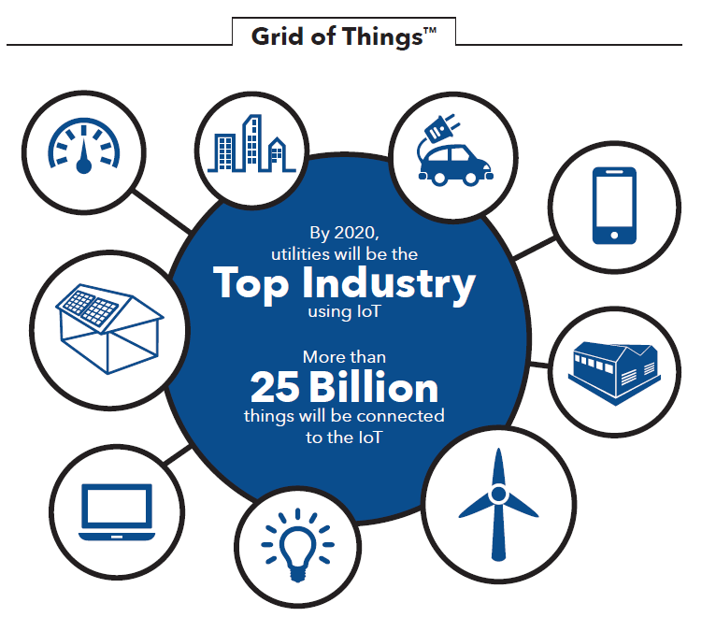
Evolving Grid: Digital & Smart
$2 trillion is expected to be invested globally over the next decade to modernize grid infrastructure
The future grid will manage centralized generation in concert with hundreds of thousands of distributed energy resources
Internet of Things (IoT): Sensors, automation and data analytics will be added, improving visibility, control and efficiency
Notes:
Grid is evolving at a rapid pace – estimated about $2 trillion dollars will be spent globally over the next decade
The existing grid infrastructure – the wires, transformers, breakers, etc – were designed for one-way flow from centralized plants to customers
With proliferation of distributed energy resources, the infrastructure needs to be modernized to allow two-way, network flow
Expected that soon everything that connects to the grid will have an internet address
The electricity system will be integral part of the famous “Internet of Things”
This connectivity will allow for unprecedented visibility and control, allowing the IESO and other grid operators to operate the grid more efficiently
At the distribution level, advanced technology will improve utilities ability to respond to outages and restore electricity faster.

Slide 14


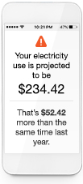
Evolving Customers: the Prosumer
21st century customers expect more from utilities, including clean, reliable, affordable electricity and services tailored to individual needs
Customers are increasingly shifting from passive consumers to proactive, producing consumers or “prosumers”
Monitoring/managing consumption
Multi-platform, real-time connection to utility
Connecting solar, batteries, electric vehicles in homes
Notes:
Accustomed to a high degree of service from companies such as Amazon and Apple, customers today expect more from their utilities
Customers have always expected reliable and affordable electricity
Today they also expect electricity to be produced from clean resources and to have more control over their energy choices
Not only are expectations higher, the lines between consumers and producers is blurring
We refer to this new type of consumer as the “prosumer”
There are many examples of this trend:
Residential customers want to have rooftop solar so they can generate their own electricity – now with the possibility of being complimented with storage - Tesla introduced the Powerwall residential storage unit last year
Customers are also installing smart thermometers, such as the Nest, and other devices in their homes to manage their energy use.
In addition, cities want to have micro-grids, which are local mini-grids that can disconnect from the broader grid
Large commercial customers want renewable energy to meet their corporate sustainability goals

Slide 15
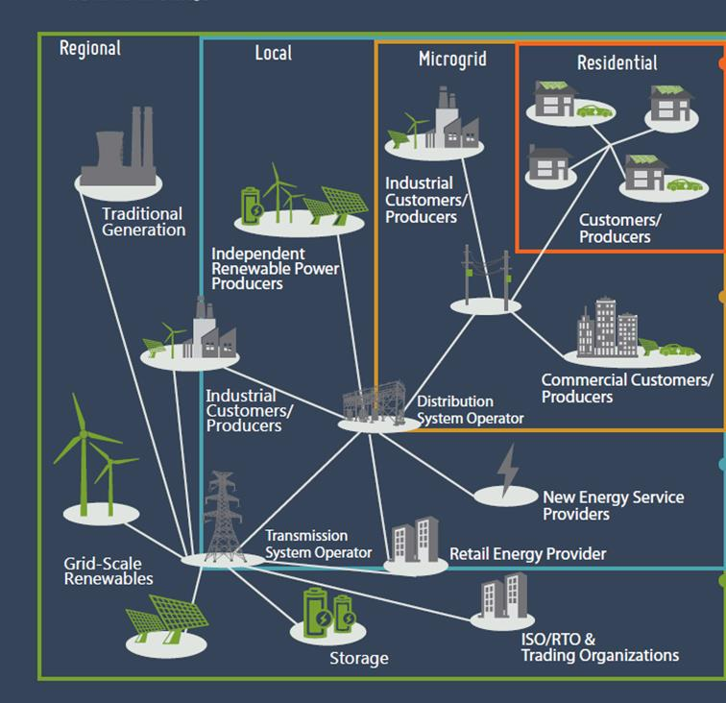
Evolving Market: Toward Transactive Energy?
One emerging concept for a distributed smart grid: “transactive energy”
Automated response, based on price, cost, other factors
Level of response is voluntary and set by the asset owner
Challenge: how to create a system that properly values price, reliability, and individual preferences
Image source: Gridwise Alliance
Notes:
This is a diagram developed by the Gridwise Alliance in the United States and it illustrates a new concept for sharing distributed control over the power grid at each level of the power system:
The bulk electricity system – or “regional level”
The distribution - or “local” level
Microgrids, or community power systems, and ultimately….
…. your house.
Transactive energy is a new concept that is being developed. The concept is to allow all controllable devices connected to our power grid to directly “transact” with one another – seamlessly, automatically, and with the ability to adapt to customer preferences as they change over time.
One way to think of it is as an internet-enabled free market, where customer devices and grid systems can barter over the proper way to solve their mutual problems, and settle on the proper price for their services, in close to real time.
Part of the challenge facing proponents of transactive energy is figuring out how to create a system that properly values price, reliability, and individual preferences, and brings these factors together into one automated and integrated grid.

Slide 16

IESO Energy Storage Initiatives
IESO’s ‘Alternative Technologies for Regulation’ (ATR) procurement (2012)
2 MW flywheel – operated by NRStor
4 MW battery – operated by Renewable Energy Systems Canada (RES)
IESO’s Storage Phase 1 procurement (2014)
12 projects totalling ~34MW providing voltage control or frequency regulation services
technologies: batteries, flywheel, thermal energy, power-to-gas
IESO’s Storage Phase 2 procurement (2015)
9 projects totalling ~16 MW providing capacity
technologies: batteries, compressed air
Notes:
Another initiative we undertook was the procurement of storage
Purpose of these pilots is to learn how to integrate these technologies into our daily operations on a smaller scale in preparation for larger scale deployment later on
Can see that over the past 4 years have undertaken 3 different storage procurements utilizing a variety of technologies
Our objective with respect to any service the electricity grid needs (automated generation control, reactive support & voltage control, capacity, storage, demand response) is to be agnostic with respect to the technology that provides the service – it is the ability to meet our requirements and the cost to consumers that matters

Slide 17
Where is the Sector Headed?

Slide 18
Market Renewal: Why?
20 year old Market Design and Tools
Inefficiencies in our current market design
The sector is changing

Slide 19
Market Renewal Overview
OBJECTIVES
Single Schedule System
Distributed Energy Resources
Significantly Improve Efficiency
Prepare for Future Change
Day-Ahead Market
Increased Electrification
+
Enhanced Unit Commitment
Decarbonization
Capacity Auction
Increased Regional Coordination
Enabling System Flexibility
New Technologies
Initiatives
Context

Slide 20
Market Renewal Priorities
Market Renewal
Focus on Efficiency
Value for Consumers
Transparent Process
Practical Solutions
Flexible to Future Change
Reflect Stakeholder Feedback

Slide 21
Timeline
Over the next 18 months, the IESO will be educating and working with stakeholders on the key design concepts for the various initiatives
MRWG and MR SE meetings will be held regularly, and CEO Roundtable meetings quarterly
In the short-term, a revised Terms of Reference for the MRWG and a revised Market Renewal SE Plan will be developed, and the benefits case will be released by the end of Q1 2017
Timelines are subject to change based on design and implementation decisions to be made with stakeholders, but 2017 will focus on building stakeholder support and initiating market design activities
Each project within the Market Renewal Program has its own drivers and timelines, with some being able to be designed and implemented in a few years; others will require more time due to the complexity and linkages
 | 2016 |  |  |  | 2017 |  |  |  | 2018 |  |  |  | 2019 |  |  |  | 2020+
Benefits Case
Design
Implementation
Note: indicates potential work

Slide 22
Stakeholder Engagement Framework
The Market Renewal Working Group has been established as the key stakeholder vehicle for dedicated, in depth discussions of the project
The Working Group has been meeting on a monthly basis or as needed
Comprised of 13 individuals representing generators, traders and customers, the Working Group has been vital in the development of the Benefits Case
The IESO will re-examine membership to ensure the WG is best equipped for the next phase of Market Renewal
Going forward, the WG will review issues and establish priorities and will be supported by sub-committees
The IESO will also create an external CEO Roundtable comprised of CEOs or Senior Executives to provide advice to the IESO CEO and Executive.

Slide 23
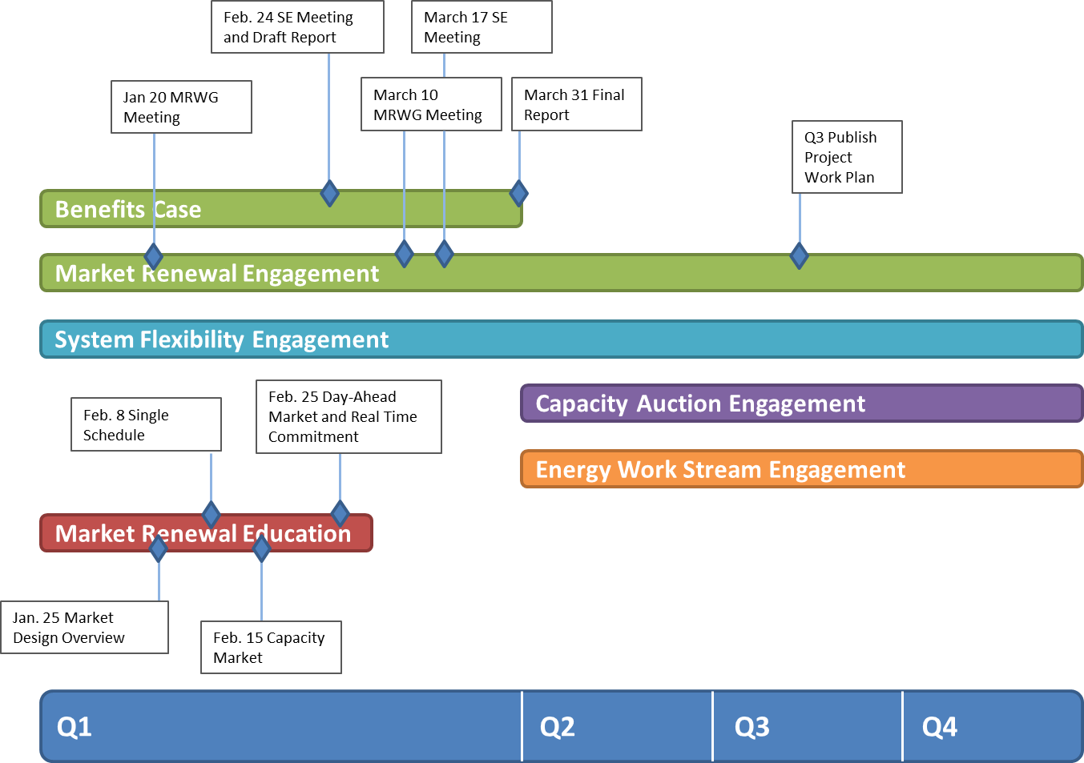
2017 Stakeholder Engagement Timeline

Slide 24




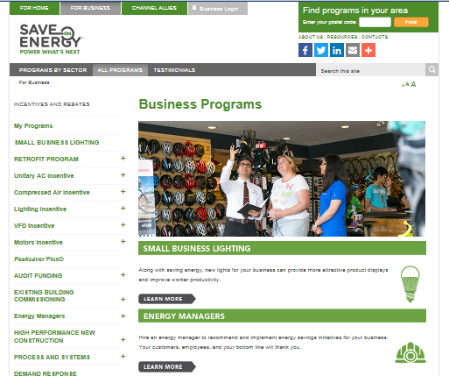

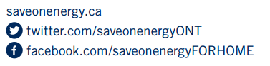
IESO Resources – Keep in Touch

